Slide 1




















General Icons – Light Backgrounds
3/3
AWS Marketplace
Client
Disk
Forums
Generic database
Internet
Internet alt1
Internet alt2
Mobile client
Firewall
Email
Multimedia
Office building
SAML token
SSL padlock
Tape storage
Traditional server
User
Users
Toolkit
SDK

Slide 2

Analytics
STANDARD CATEGORY ICON

Slide 3







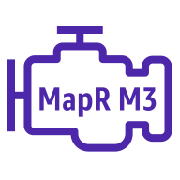


Analytics
1/5
Amazon CloudSearch
Amazon EMR
Amazon Kinesis
Search documents
HDFS
cluster
Cluster
EMR engine
EMR engine
mapR M3
EMR engine
mapR M5
EMR engine
mapR M7

Slide 4




Analytics
2/5
Amazon Kinesis Video Streams
Amazon Kinesis Data Streams
Amazon Kinesis Data Firehose
Amazon Kinesis Data Analytics

Slide 5








Analytics
3/5
AWS Glue
Amazon Athena
Amazon Elasticsearch Service
Amazon Redshift
Crawler
Dense compute node
AWS glue data catalog
Dense storage node

Slide 6





Analytics
4/5
Amazon QuickSight
AWS Lake Formation
AWS Data Pipeline
Amazon Managed Streaming for Kafka
Data lake

Slide 7

Analytics
5/5
AWS Data Exchange

Slide 8

Application Integration
STANDARD CATEGORY ICON

Slide 9



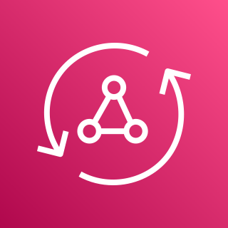





Application Integration
1/3
Amazon Simple
Notification Service
Amazon Simple Queue Service
Amazon MQ
AWS AppSync
Email notification
Message
HTTP notification
Queue
Topic

Slide 10









Application Integration
2/3
AWS Step Functions
Amazon EventBridge
AWS Console Mobile Application
AWS Express Workflows
Event
Default
event bus
Custom
event bus
SaaS
event bus
Rule

Slide 11

Application Integration
3/3
AWS AppFlow

Slide 12

AR & VR
STANDARD CATEGORY ICON

Slide 13

AR & VR
1/1
Amazon Sumerian

Slide 14

AWS Cost Management
STANDARD CATEGORY ICON

Slide 15




AWS Cost Management
1/2
AWS Budgets
AWS Cost & Usage Report
AWS Cost Explorer
Reserved Instance Reporting

Slide 16

AWS Cost Management
2/2
Savings Plans

Slide 17

Blockchain
STANDARD CATEGORY ICON

Slide 18



Blockchain
1/1
Amazon Managed Blockchain
Amazon Quantum Ledger Database
Blockchain

Slide 19

Business Applications
STANDARD CATEGORY ICON

Slide 20



Business Applications
1/1
Alexa for Business
Amazon Chime
Amazon WorkMail

Slide 21

Compute
STANDARD CATEGORY ICON

Slide 22




















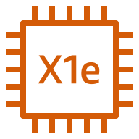


Compute
1/8
Resource Icons
Amazon EC2
AMI
Auto
scaling
Elastic IP address
Rescue
Instance
A1 instance
M4 instance
R5a instance
Z1d instance
H1 instance
Instances
T3 instance
C5 instance
R4 instance
P3 instance
I3 instance
Spot instance
T2 instance
C5n instance
X1e instance
P2 instance
D2 instance

Slide 23













Compute
2/8
Amazon EC2
DB instance
M5 instance
C4 instance
X1 instance
High memory instance
Instance with
CloudWatch
M5a instance
R5 instance
G3 instance
F1 instance
M6g instance
R6g instance
C6g instance

Slide 24







Compute
3/8
AWS Elastic Beanstalk
AWS Lambda
Amazon Lightsail
Amazon EC2 Auto Scaling
Deployment
Lambda function
Application

Slide 25



Compute
4/8
AWS Batch
AWS Outposts
AWS Serverless Application Repository

Slide 26




Compute
5/8
Vmware Cloud on AWS
AWS Thinkbox Deadline
AWS Thinkbox XMesh
AWS Thinkbox Frost

Slide 27




Compute
6/8
AWS Thinkbox Krakatoa
AWS Thinkbox Sequoia
AWS Thinkbox Stoke
AWS Wavelength

Slide 28




Compute
7/8
AWS Compute Optimizer
AWS Local Zones
EC2 Image Builder
Bottlerocket

Slide 29

Compute
8/8
AWS Parallel Cluster

Slide 30

Containers
STANDARD CATEGORY ICON

Slide 31











Containers
1/1
Amazon Elastic
Container Kubernetes
Amazon Elastic Container Registry
Amazon Elastic Container Service
AWS Fargate
Registry
Container 1
Container 2
Image
Container 3
Service
Task

Slide 32

Customer Enablement
STANDARD CATEGORY ICON

Slide 33




Customer Enablement
1/1
AWS IQ
AWS Managed Services
AWS Professional Services
AWS Support

Slide 34

Customer Engagement
STANDARD CATEGORY ICON

Slide 35




Customer Engagement
1/1
Amazon Connect
Amazon Pinpoint
Amazon Simple Email Service
Email

Slide 36

Database
STANDARD CATEGORY ICON

Slide 37

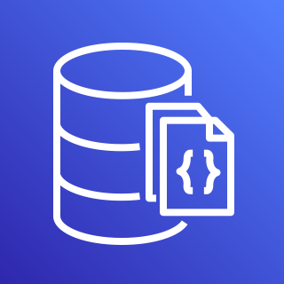








Database
1/5
Amazon Aurora
Amazon DocumentDB (with MongoDB compatibility)
Amazon DynamoDB
Attribute
Items
Amazon DynamoDB Accelerator (DAX)
Item
Table
Attributes
Global secondary
index

Slide 38







Database
2/5
Amazon Redshift
AWS Database
Migration Service
Amazon Neptune
Amazon Quantum Ledger Database
Dense compute node
Database migration workflow/job
Dense storage node

Slide 39







Database
3/5
Amazon RDS
Amazon RDS on VMware
Amazon Timestream
Amazon ElastiCache
Cache node
ElastiCache
for Redis
ElastiCache for Memcached

Slide 40

Database
4/5
Amazon Keyspaces

Slide 41











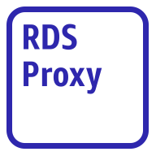
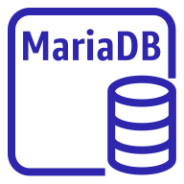
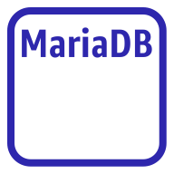


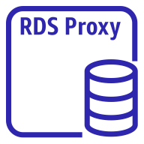
Database
5/5
Amazon Aurora instance
Amazon Aurora instance alternate
Amazon RDS instance
Amazon RDS
instance alternate
MySQL
instance
MySQL
instance alternate
Oracle
instance
Oracle
Instance alternate
Postgre SQL instance
Postgre SQL
instance alternate
PIOPS
Amazon RDS
proxy alternate
MariaDB instance
MariaDB instance alternate
SQL server
instance
SQL server
Instance alternate
Amazon RDS
proxy

Slide 42

Developer Tools
STANDARD CATEGORY ICON

Slide 43





Developer Tools
1/3
AWS Cloud9
AWS CodeBuild
AWS CodeCommit
AWS CodeDeploy
AWS Cloud9

Slide 44




Developer Tools
2/3
AWS CodePipeline
AWS CodeStar
AWS Command Line Interface
AWS Tools and SDKs

Slide 45

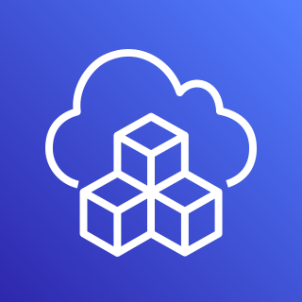

Developer Tools
3/3
AWS X-Ray
AWS Cloud Development Kit
AWS CodeArtifact

Slide 46

End User Computing
STANDARD CATEGORY ICON

Slide 47

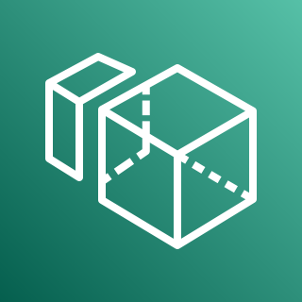


End User Computing
1/1
Amazon AppStream 2.0
Amazon WorkSpaces
Amazon WorkLink
Amazon WorkDocs

Slide 48

Game Tech
STANDARD CATEGORY ICON

Slide 49


Game Tech
1/1
Amazon GameLift
Amazon Lumberyard

Slide 50

Internet of Things
STANDARD CATEGORY ICON

Slide 51









Internet of Things
1/5
Amazon FreeRTOS
AWS loT 1-Click
AWS loT Analytics
AWS loT Button
Channel
Data set
Pipeline
Notebook
Data store

Slide 52





Internet of Things
2/5
AWS loT Core
AWS loT Device Defender
AWS loT Device Management
AWS loT Events
loT device jobs

Slide 53




Internet of Things
3/5
AWS loT Greengrass
AWS loT SiteWise
AWS loT Things Graph
Connector

Slide 54

























Internet of Things
4/5
loT action
loT actuator
loT certificate
loT desired state
loT hardware board
loT HTTP protocol
loT HTTP/2 protocol
loT MQTT protocol
loT policy
loT reported state
loT rule
loT sensor
loT servo
loT shadow
loT simulator
loT topic
Alexa skill
Alexa voice service
Alexa-enabled device
Echo
Fire TV
Fire TV stick
Lambda function
Over-the-air update
Device gateway

Slide 55
















Internet of Things
5/5
loT thing bank
loT thing bicycle
loT thing camera
loT thing car
loT thing cart
loT thing coffee pot
loT thing door lock
loT thing factory
loT thing generic
loT thing house
loT thing lightbulb
loT thing travel
loT thing medical emergency
loT thing police emergency
loT thing utility
loT thing windfarm

Slide 56

Machine Learning
STANDARD CATEGORY ICON

Slide 57




Machine Learning
1/6
Amazon Comprehend
Amazon Elastic Inference
Amazon Forecast
Amazon Lex

Slide 58









Machine Learning
2/6
Amazon Personalize
Amazon Polly
Amazon Rekognition
Amazon SageMaker
Amazon Rekognition image
Notebook
Amazon Rekognition video
Model
Train

Slide 59




Machine Learning
3/6
Amazon SageMaker Ground Truth
Amazon Textract
Amazon Transcribe
Amazon Translate

Slide 60




Machine Learning
4/6
AWS Deep Learning AMIs
AWS Deep Learning Containers
AWS DeepLens
AWS DeepRacer

Slide 61



Machine Learning
5/6
Apache MXNet on AWS
TensorFlow on AWS
AWS DeepComposer
Amazon Augmented AI

Slide 62




Machine Learning
6/6
Amazon Fraud Detector
Amazon Kendra
Amazon CodeGuru
TorchServe

Slide 63

Management & Governance
STANDARD CATEGORY ICON

Slide 64












Management & Governance
1/7
Amazon CloudWatch
AWS Auto Scaling
AWS CloudFormation
AWS CloudTrail
Alarm
Rule
Change set
Stack
Event (event-based)
Event (time-based)
Template
Logs

Slide 65




Management & Governance
2/7
AWS Command Line Interface
AWS Config
AWS License Manager
AWS Managed Services

Slide 66











Management & Governance
3/7
AWS Management Console
AWS OpsWorks
AWS Personal Health Dashboard
Apps
Instances
Monitoring
Permissions
Deployments
Layers
Resources
Stack2

Slide 67











Management & Governance
4/7
AWS Service Catalog
AWS Systems Manager
Automation
Documents
Patch manger
Parameter store
OpsCenter
Inventory
Maintenance windows
State manager
Run command

Slide 68








Management & Governance
5/7
AWS Trusted Advisor
AWS Well-Architected Tool
AWS Control Tower
Checklist
cost
Checklist
performance
Checklist
security
Checklist
fault tolerant
Checklist

Slide 69
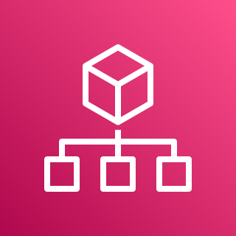





Management & Governance
6/7
AWS Organizations
AWS AppConfig
AWS Chatbot
AWS Backint Agent
Account
Organizational unit

Slide 70

Management & Governance
7/7
Application Auto Scaling

Slide 71

Media Services
STANDARD CATEGORY ICON

Slide 72




Media Services
1/4
Amazon Elastic Transcoder
Amazon Kinesis Video Stream
AWS Elemental MediaConnect
AWS Elemental MediaConvert

Slide 73




Media Services
2/4
AWS Elemental MediaLive
AWS Elemental MediaPackage
AWS Elemental MediaStore
AWS Elemental MediaTailor

Slide 74

Media Services
3/4
AWS Elemental Conductor
AWS Elemental Delta
AWS Elemental Live
AWS Elemental Server

Slide 75


Media Services
4/4
Amazon Interactive Video
AWS Elemental Link

Slide 76

Migration & Transfer
STANDARD CATEGORY ICON

Slide 77





Migration & Transfer
1/2
AWS Application Discovery Service
AWS Database Migration Service
AWS DataSync
AWS Migration Hub
Agent

Slide 78






Migration & Transfer
2/2
AWS Server Migration Service
AWS Transfer Family
CloudEndure Migration
AWS FTPS
AWS SFTP
AWS FTP

Slide 79

Mobile
STANDARD CATEGORY ICON

Slide 80



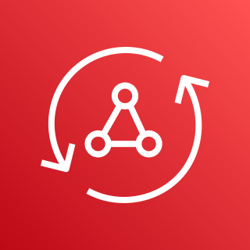

Mobile
1/2
Amazon API Gateway
Amazon Pinpoint
AWS Amplify
AWS AppSync
Endpoint

Slide 81

Mobile
2/2
AWS Device Farm

Slide 82

Networking & Content Delivery
STANDARD CATEGORY ICON

Slide 83








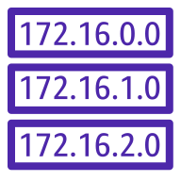

Networking & Content Delivery
1/4
Amazon API Gateway
Amazon CloudFront
Amazon Route 53
AWS PrivateLink
Endpoint
Download distribution
Hosted zone
Edge location
Route table
Streaming distribution

Slide 84














Networking & Content Delivery
2/4
Amazon VPC
Customer gateway
Internet gateway
VPN gateway
Flow logs
Endpoints
Router
Traffic mirroring
NAT gateway
Elastic network interface
Elastic network adapter
Network access control list
VPN connection
Peering connection

Slide 85













Networking & Content Delivery
3/4
AWS App Mesh
AWS Cloud Map
AWS Direct Connect
AWS Global Accelerator
Mesh
Virtual
gateway
Service
Gateway
Virtual node
Virtual router
Namespace
Virtual service
Resource

Slide 86







Networking & Content Delivery
4/4
AWS Transit Gateway
AWS Client VPN
AWS Site-to-Site VPN
Elastic Load Balancing
Application load balancer
Classic load balancer
Network load balancer

Slide 87

Quantum Technologies
STANDARD CATEGORY ICON

Slide 88

Quantum Technologies
1/1
Amazon Braket

Slide 89

Robotics
STANDARD CATEGORY ICON

Slide 90





Robotics
1/1
AWS RoboMaker
Cloud extensions ROS
Development environment
Fleet
management
Simulation

Slide 91

Satellite
STANDARD CATEGORY ICON

Slide 92

Satellite
1/1
AWS Ground Station

Slide 93

Security, Identity, & Compliance
STANDARD CATEGORY ICON

Slide 94





Security, Identity, & Compliance
1/5
Amazon Cloud Directory
Amazon Cognito
Amazon GuardDuty
Amazon Inspector
Agent

Slide 95





Security, Identity, & Compliance
2/5
Amazon Macie
AWS Artifact
AWS Certificate Manager
AWS CloudHSM
Certificate authority

Slide 96
















Security, Identity, & Compliance
3/5
AWS Directory Service
AWS Firewall Manager
AWS Identity & Access Management
Simple AD
Add-on
Permissions
MFA token
AWS STS
AWS STS (alternate)
Long-term security
credential
AD Connector
Encrypted data
Data encryption key
AWS Managed Microsoft AD
Role
AWS IAM Access analyzer

Slide 97






Security, Identity, & Compliance
4/5
AWS Key Management Service
AWS Secrets Manager
AWS Security Hub
AWS Shield
Finding
AWS shield advanced

Slide 98





Security, Identity, & Compliance
5/5
AWS Single Sign-On
AWS WAF
Amazon Detective
AWS Resource
Access Manager
Filtering rule

Slide 99

Storage
STANDARD CATEGORY ICON

Slide 100














Storage
1/4
Amazon Elastic Block Store
Amazon Elastic File System
AWS Backup
AWS Storage Gateway
Snapshot
File system
Non-cached
volume
Cached
volume
Volume
Virtual tape
library
Tape
gateway
Multiple volumes
Volume
gateway
File
gateway

Slide 101



Storage
2/4
Amazon FSx for Lustre
Amazon FSx for Windows File Server
CloudEndure Disaster Recovery
File system
File system

Slide 102

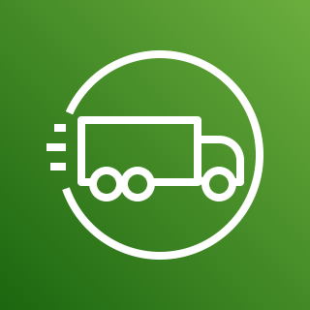



Storage
3/4
AWS Snowball Edge
AWS Snowmobile
AWS Snowball
AWS Snowcone
Snowball import-export

Slide 103

















Storage
4/4
Amazon Simple Storage Service (S3)
Amazon S3 Glacier
S3 Intelligent- Tiering
S3 Glacier
S3 Glacier Deep Archive
Vault
Archive
S3 Standard
S3 One Zone-IA
S3 Standard-IA
Bucket with
objects
Access points
VPC access points
Bucket
Replication time control
Replication
Object

